Slide 1

CS 4470: Artificial Intelligence
Constraint Satisfaction Problems
Instructor: Imtiaz Parvez
Utah Valley University
[Adapted from slides by George Rudolph, Dan Klein, Pieter Abbeel, Sergey Levine, ai.berkeley.edu]

Slide 2

Constraint Satisfaction
Find solution that satisfies multiple constraints
Not just for finding a sequential plan

Slide 3
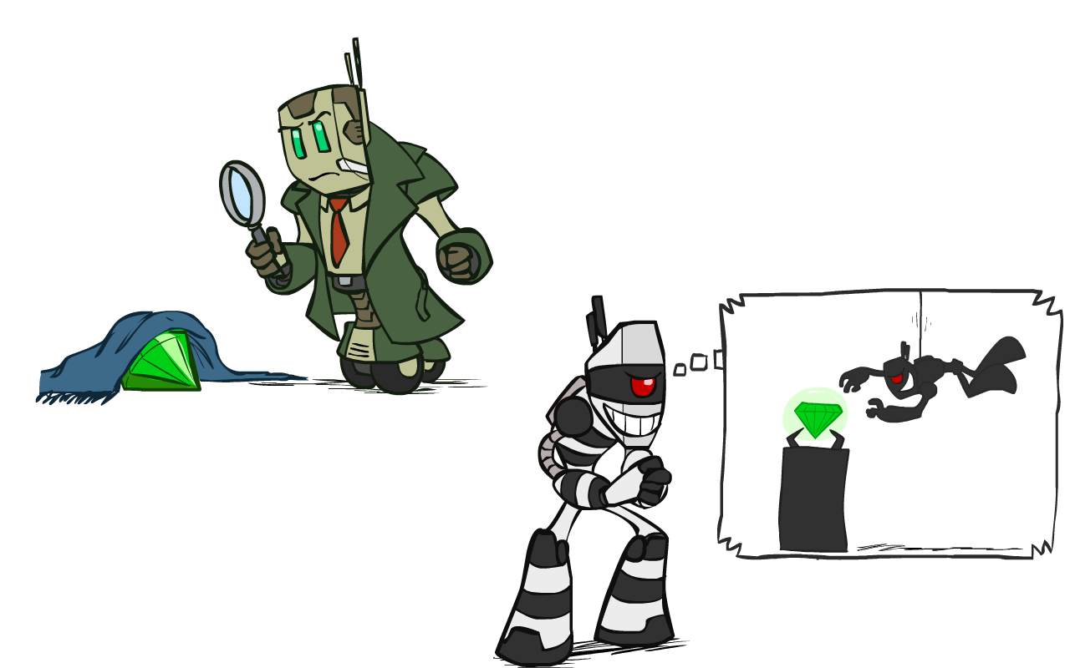
What is Search For?
Assumptions about the world:
a single agent
deterministic actions
fully observed state
discrete state space
Planning: sequences of actions
The path to the goal is the important thing
Paths have various costs, depths
Identification: assign values to variables
The goal is important, not the path
All paths at the same depth (for some formulations)
CSPs are a specialized class of identification problems

Slide 4


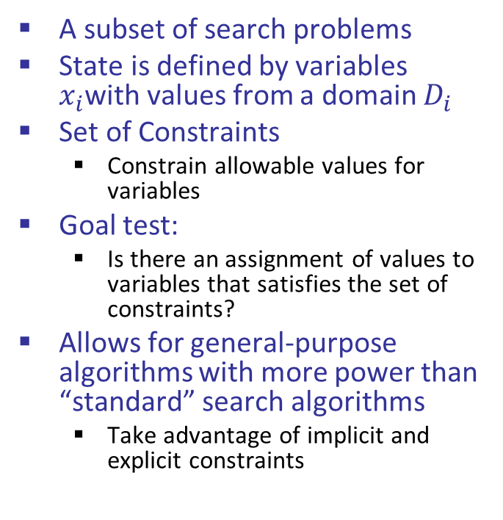
Constraint Satisfaction Problems
Standard Search
Constraint Satisfaction
State is a “black box”: arbitrary data structure
Goal test can be any function over states
Successor function can also be anything
A subset of search problems
State is defined by variables $x_{i}$with values from a domain $D_{i}$
Set of Constraints
Constrain allowable values for variables
Goal test:
Is there an assignment of values to variables that satisfies the set of constraints?
Allows for general-purpose algorithms with more power than “standard” search algorithms
Take advantage of implicit and explicit constraints

Slide 5
CSP Example: 3-Color Maps

Slide 6


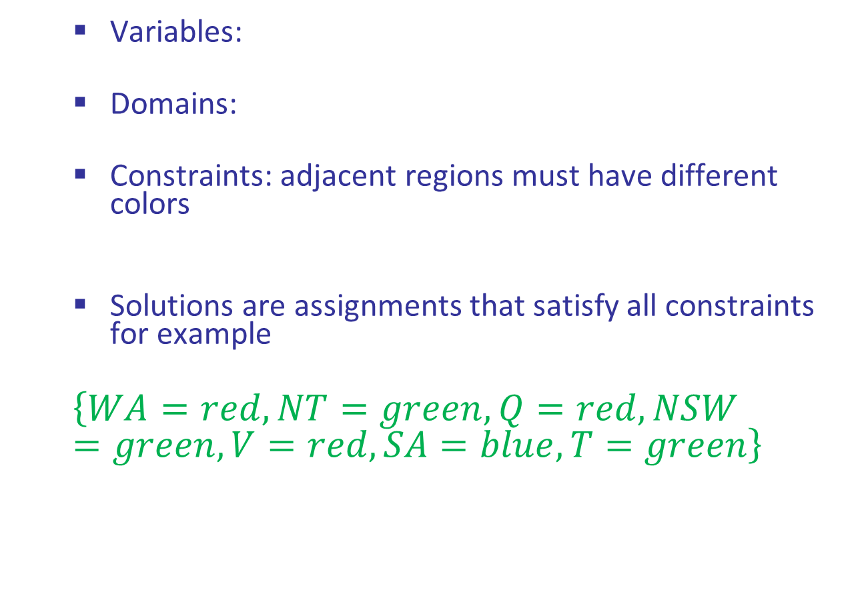
Example: Map Coloring
Variables:
Domains:
Constraints: adjacent regions must have different colors
Solutions are assignments that satisfy all constraints for example
$$\left\{WA=red, NT=green, Q=red, NSW=green, V=red, SA=blue, T=green\right\}$$
Implicit:
Explicit (enumeration) :

Slide 7
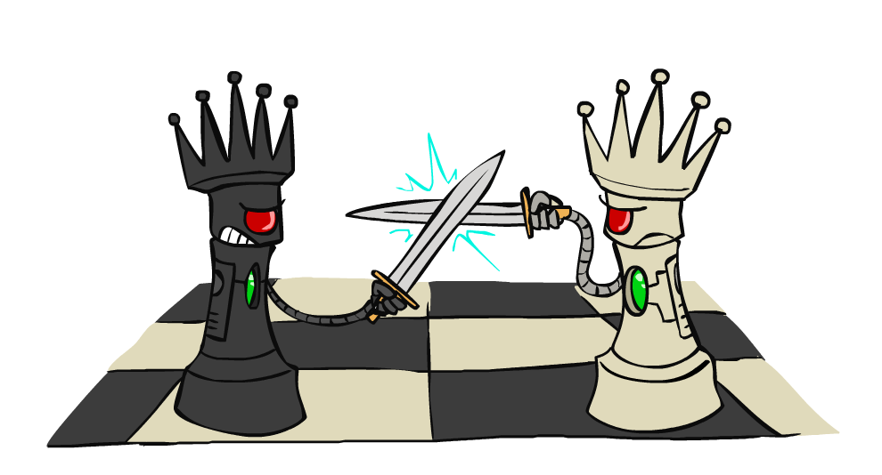
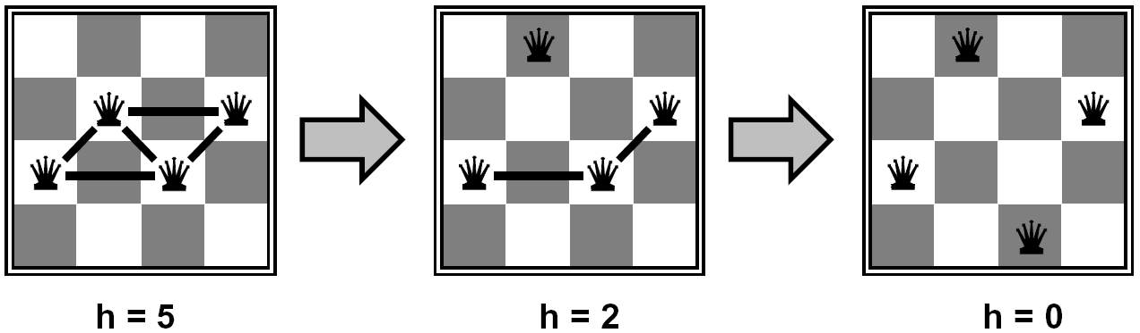
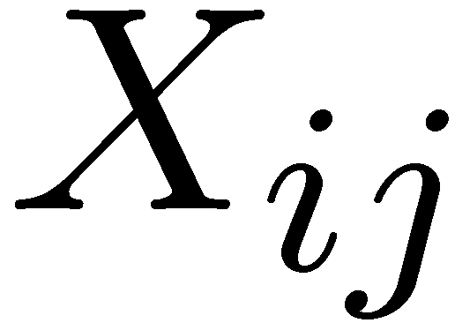

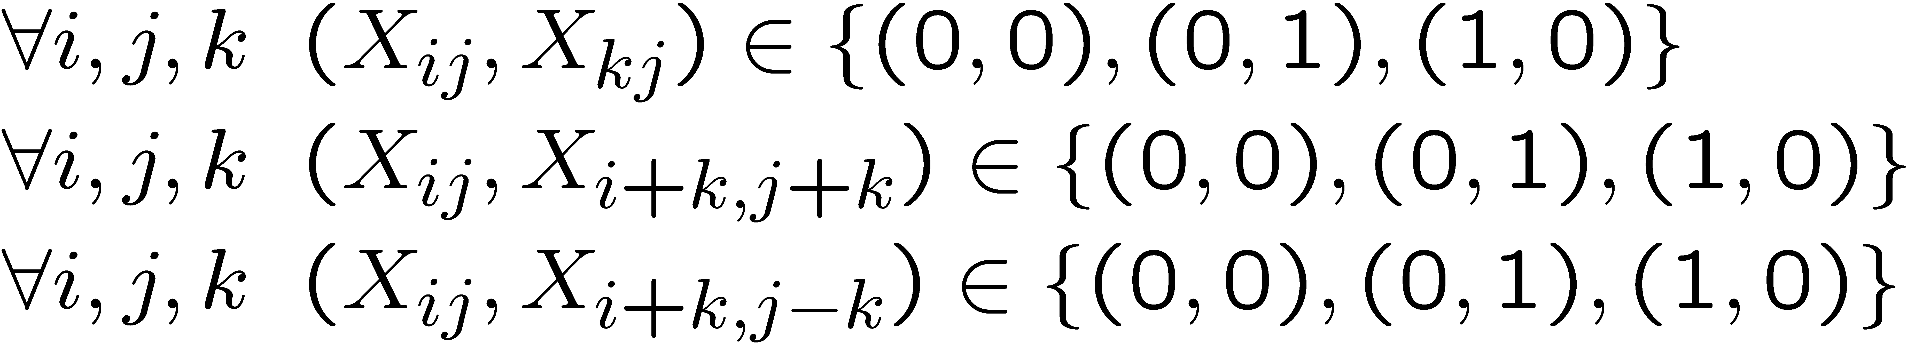
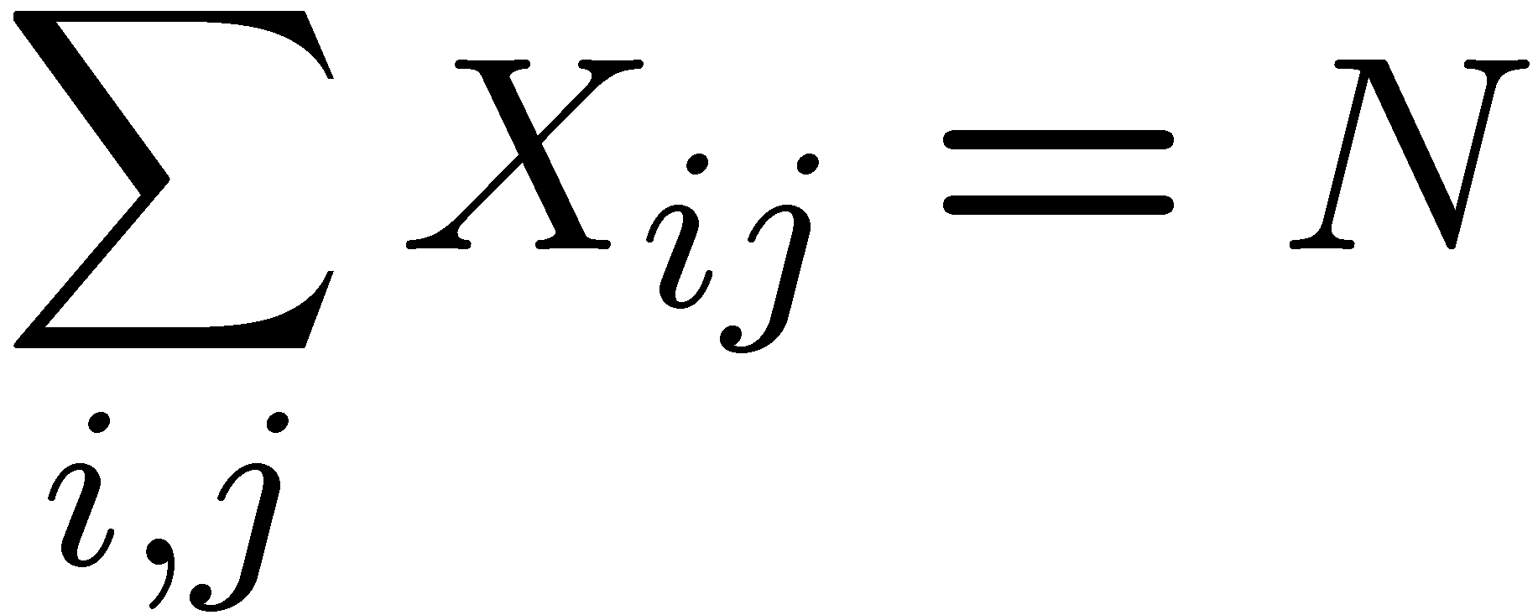
Example: N-Queens
Formulation 1:
Variables:
Domains:
Constraints

Slide 8







Example: N-Queens
Formulation 2:
Variables:
Domains:
Constraints:
Implicit:
Explicit:

Slide 9
Constraint Hypergraphs

Slide 10
3-Color Problem Graph
Binary CSP
each constraint relates (at most) two variables
Binary constraint graph
nodes are variables
arcs show constraints
General-purpose CSP algorithms
use graph structure to speed up search
Example: Tasmania is an independent subproblem
Notes:
Demo:
N-queens problem at AISpace2
Note that older AISpace used C++ and Java
AISpace2 uses Python, Node.js and Jupyter Notebooks Can skip if pressed for time. Useful for students to explore or giving away too much????

Slide 11

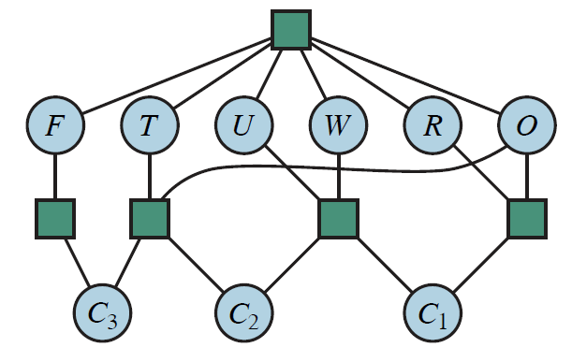
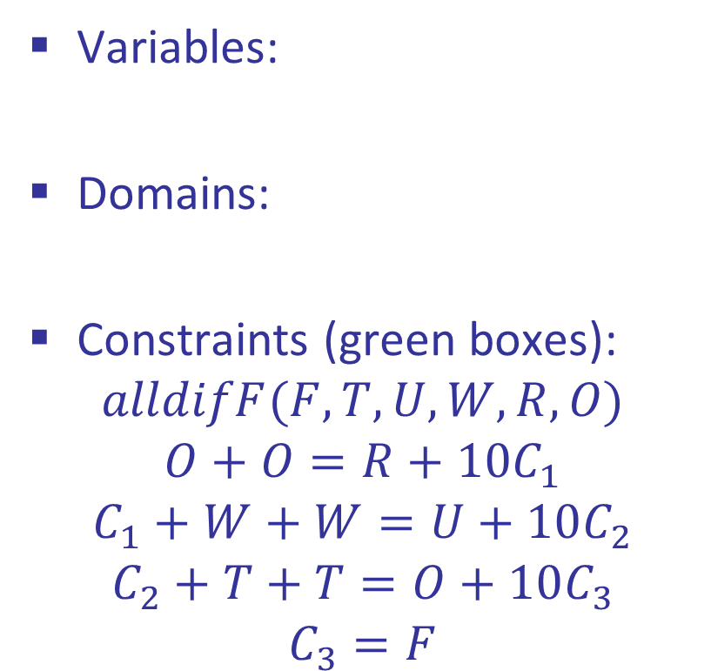
Cryptarithmetic Example
Variables:
Domains:
Constraints (green boxes):
$$alldifF(F,T,U,W,R,O)$$
$$O+O=R+{10C}_{1}$$
$$C_{1}+W+W=U+10C_{2}$$
$$C_{2}+T+T=O+10C_{3}$$
$$C_{3}=F$$
Notes:
0=7, R=4, W=6, U=2, T=8, F=1; 867 + 867 = 1734

Slide 12
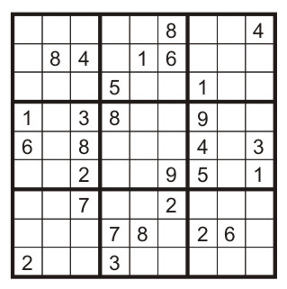
Example: Sudoku
Variables:
Each (open) square
Domains:
{1,2,…,9}
Constraints:
9-way alldiff for each column
9-way alldiff for each row
9-way alldiff for each region
(or can have a bunch of pairwise inequality constraints)

Slide 13

Varieties of CSPs and Constraints

Slide 14

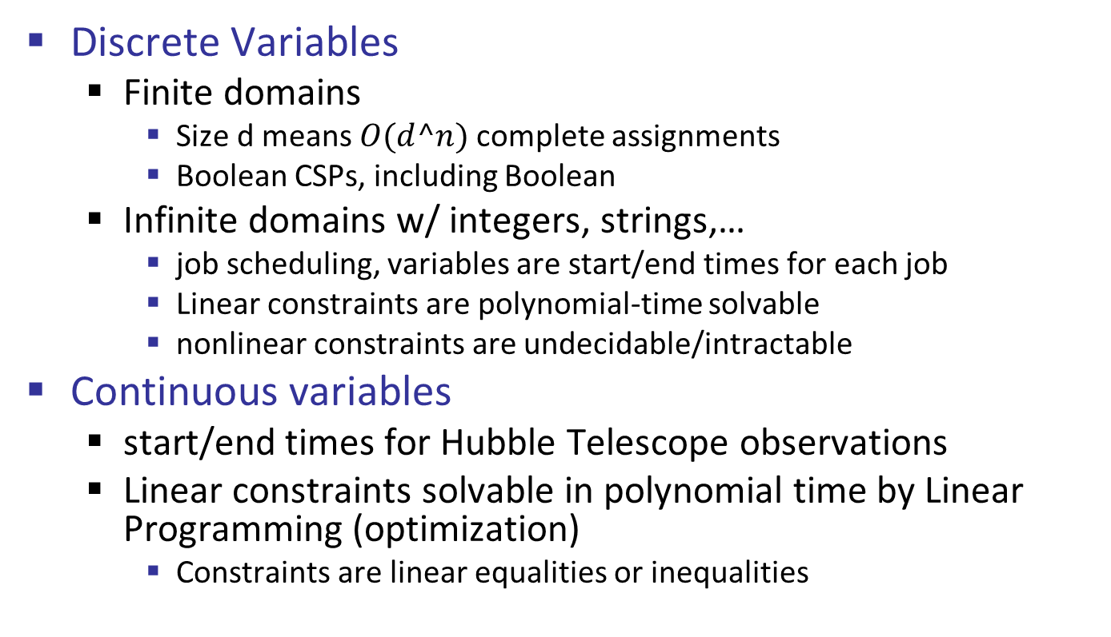
Varieties of CSPs
Discrete Variables
Finite domains
Size d means $O(d^n)$complete assignments
Boolean CSPs, including Boolean
Infinite domains w/ integers, strings,…
job scheduling, variables are start/end times for each job
Linear constraints are polynomial-time solvable
nonlinear constraints are undecidable/intractable
Continuous variables
start/end times for Hubble Telescope observations
Linear constraints solvable in polynomial time by Linear Programming (optimization)
Constraints are linear equalities or inequalities

Slide 15


Absolute Constraints vs Preferences
Unary constraints involve a single variable (equivalent to reducing domains), for example:
Binary constraints involve pairs of variables:
Higher-order constraints involve 3 or more variables:
cryptarithmetic column constraints
Multivariable logic clauses (3-SAT or n-SAT)
Preferences/soft constraints:
Example: red is better than green
Often representable by a cost for each variable assignment
Gives constrained optimization problems
We represent these with Bayes Nets, fuzzy logic
Ignore them in our CSPs of interest

Slide 16
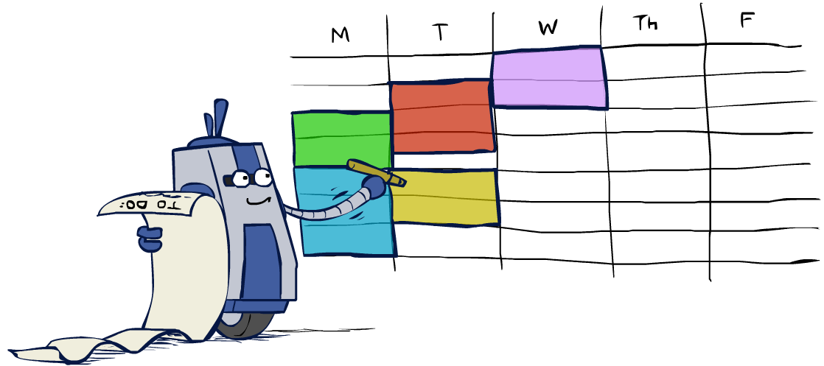
Real-World CSPs
Scheduling problems: when can we all meet?
Timetabling problems: which class is offered when and where?
Assignment problems: who teaches what class?
Hardware configuration
Transportation scheduling
Factory scheduling
Circuit layout
Fault diagnosis
… lots more!
Many real-world problems involve real-valued variables…

Slide 17

Solving CSPs

Slide 18
Standard Formulation of CSPs
States defined by the values assigned so far: partial assignments
Initial state: the empty assignment, {}
Successor function: assign a value to an unassigned variable
Goal test: the current assignment is complete and satisfies all constraints

Slide 19
Constraint Propagation: Inference in CSPs
NT
Q
WA
SA
NSW
V
Forward checking propagates information from assigned to unassigned variables, but doesn't provide early detection for all failures:
NT and SA cannot both be blue!
Why didn’t we detect this yet?
Solution: Constraint propagation
reason from constraint to constraint
A form of logical inference
Enables filtering out values that are inconsistent

Slide 20
Constraint Propagation: Inference in CSPs
Standard search makes progress by expanding a node to visit successors
A CSP problem has choices
Generate successors by assigning an unassigned variable, or
Use inference by constraint propagation

Slide 21
Constraint Propagation
Use constraints to reduce the number of legal values for one variable
#1 may trigger a reduction of choices in another variable
Repeat #2 until no more reductions are possible

Slide 22

Consistency of A Single Arc
An arc X → Y is consistent iff for every x in the tail there is some y in the head which could be assigned without violating a constraint
Forward checking: Enforcing consistency of arcs pointing to each new assignment
NT
Q
WA
SA
NSW
V
Delete from the tail!

Slide 23
Arc Consistency of an Entire CSP
A simple form of propagation makes sure all arcs are consistent:
Important: If X loses a value, neighbors of X need to be rechecked!
Arc consistency detects failure earlier than forward checking
Can be run as a preprocessor or after each assignment
What’s the downside of enforcing arc consistency?
NT
Q
WA
SA
NSW
V
Remember: Delete from the tail!

Slide 24
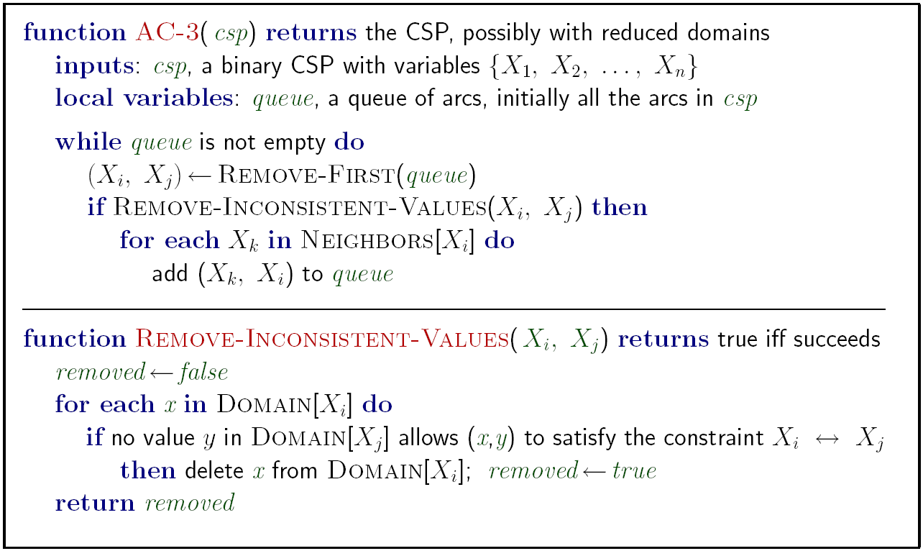

Enforcing Arc Consistency in a CSP
Runtime: $O(n2d3)$, can be reduced to $O(n2d2)$
… but detecting all possible future problems is NP-hard
Notes:
Auto-consistency (note initially nothing gets deleted/pruned since there are consistent options for all constraints for initial variable domains)
Simulator flashes whenever something needs to be re-checked

Slide 25
Limitations of Arc Consistency
After enforcing arc consistency:
Can have one solution left
Can have multiple solutions left
Can have no solutions left (and not know it)
Arc consistency still runs inside a backtracking search!
What went wrong here?
[Demo: coloring -- forward checking]
[Demo: coloring -- arc consistency]
Notes:
Demo:
CS188 javascript demos -> source -> exercises -> csps -> CSPs demos -> CSPs demos.html
Settings:
Graph = Complex
Algorithm = Backtracking
Ordering = None
Filtering = Forward Checking (first) / Arc Consistency (second)

Slide 26
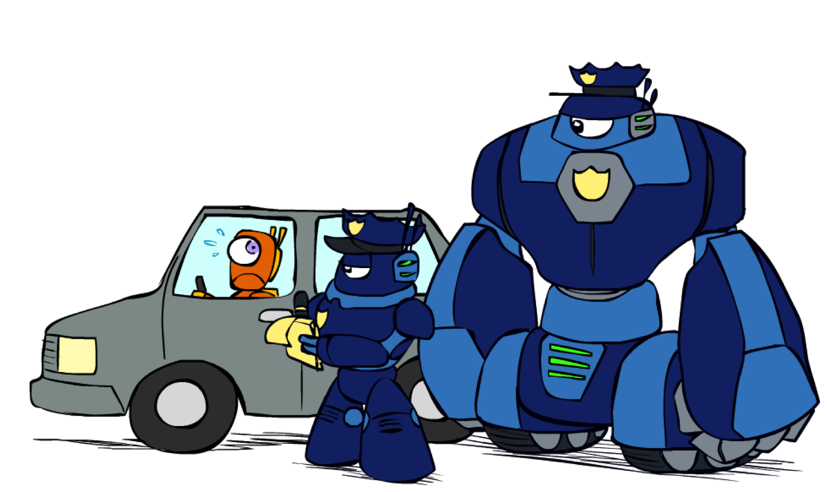
K-Consistency

Slide 27
K-Consistency
Increasing degrees of consistency
1-Consistency (Node Consistency): Each single node’s domain has a value which meets that node’s unary constraints
2-Consistency (Arc Consistency): For each pair of nodes, any consistent assignment to one can be extended to the other
K-Consistency: For each k nodes, any consistent assignment to k-1 can be extended to the kth node.
Higher k more expensive to compute
k=2 case is arc consistency

Slide 28
Strong k-Consistency
Strong k-consistency:
k-consistent and k-1, k-2, … 1 consistent
Claim: strong n-consistency means we can solve without backtracking!
Why?
Choose any assignment to any variable
Choose a new variable
By 2-consistency, there is a choice consistent with the first
Choose a new variable
By 3-consistency, there is a choice consistent with the first 2
…
Lots of middle ground between arc consistency and n-consistency!
k=3 is “path consistency”

Slide 29

Backtracking Search

Slide 30
Backtracking Search
Backtracking search is the basic uninformed algorithm for solving CSPs
Idea 1: One variable at a time
Variable assignments are commutative, so fix ordering
[WA = red then NT = green] same as [NT = green then WA = red]
Only need to consider assignments to a single variable at each step
Idea 2: Check constraints as you go
Consider only values which do not conflict with previous assignments
Might have to do some computation to check the constraints
“Incremental goal test”
Depth-first search with these two improvements
is called backtracking search (not the best name)
Can solve n-queens for n ≈ 25

Slide 31
Backtracking Example

Slide 32
Backtracking Search
Backtracking = DFS + variable-ordering + fail-on-violation
What are the choice points?
[Demo: coloring -- backtracking]
Notes:
Demo:
CS188 javascript demos -> source -> exercises -> csps -> CSPs demos -> CSPs demos.html
Settings:
Graph = Simple
Algorithm = Backtracking
Ordering = None
Filtering = None

Slide 33

Improving Backtracking
General-purpose ideas give huge gains in speed
Ordering:
Which variable should be assigned next?
In what order should its values be tried?
Filtering: Can we detect inevitable failure early?
Structure: Can we exploit the problem structure?

Slide 34

Filtering

Slide 35
Filtering: Forward Checking
Filtering: Keep track of domains for unassigned variables and cross off bad options
Forward checking: Cross off values that violate a constraint when added to the existing assignment
WA
NT
Q
SA
NSW
V
[Demo: coloring -- forward checking]
Notes:
Demo:
CS188 javascript demos -> source -> exercises -> csps -> CSPs demos -> CSPs demos.html
Settings:
Graph = Simple
Algorithm = Backtracking
Ordering = None
Filtering = Forward Checking

Slide 36

Ordering

Slide 37
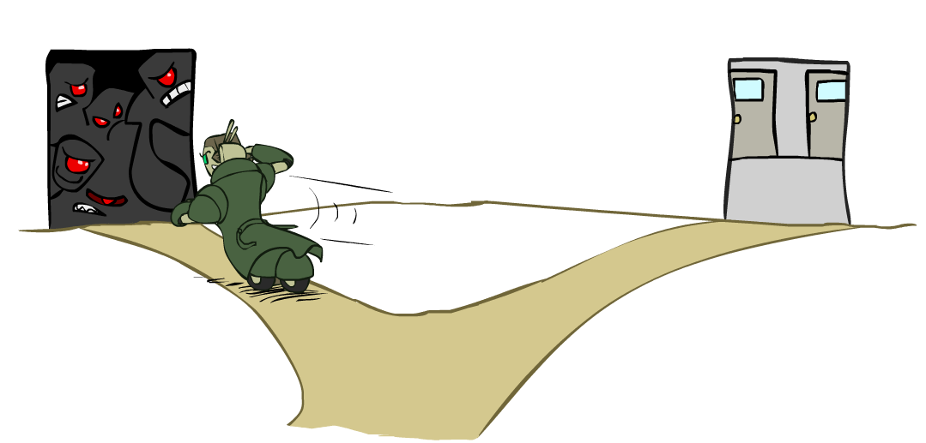
Ordering: Minimum Remaining Values
Variable Ordering: Minimum remaining values (MRV):
Choose the variable with the fewest legal values left in its domain
Why min rather than max?
Also called “most constrained variable”
“Fail-fast” ordering

Slide 38
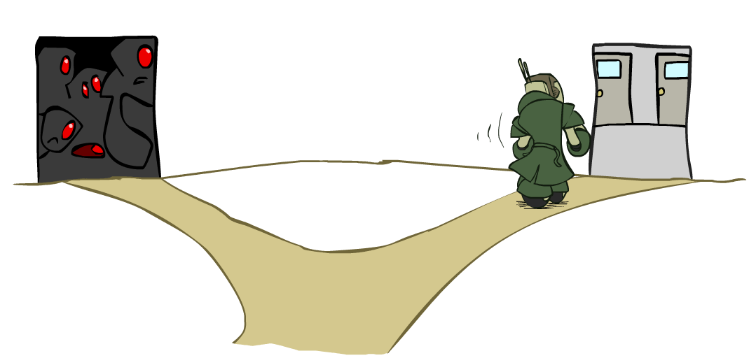
Ordering: Least Constraining Value
Value Ordering: Least Constraining Value
Given a choice of variable, choose the least constraining value
the one that rules out the fewest values in the remaining variables
It may take some computation to determine this
run filtering again
Why least rather than most?
Combining these ordering ideas makes
1000 queens feasible/tractable
[Demo: coloring – backtracking + AC + ordering]
Notes:
Demo:
CS188 javascript demos -> source -> exercises -> csps -> CSPs demos -> CSPs demos.html
Settings:
Graph = Complex
Algorithm = Backtracking
Ordering = MRV
Filtering = Forward Checking
Solves already without any need for backtracking
Note: need a bigger problem to illustrate relevance of backtracking+AC+MRV+MCV

Slide 39
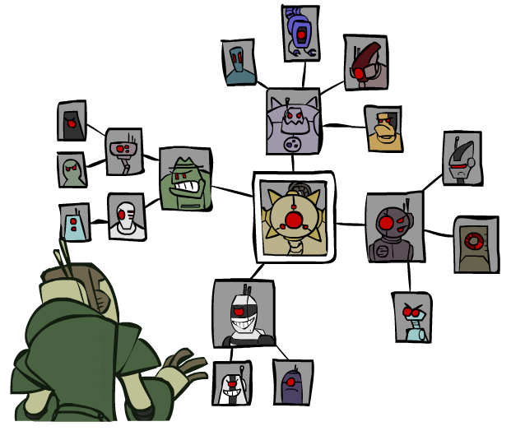
Structure

Slide 40
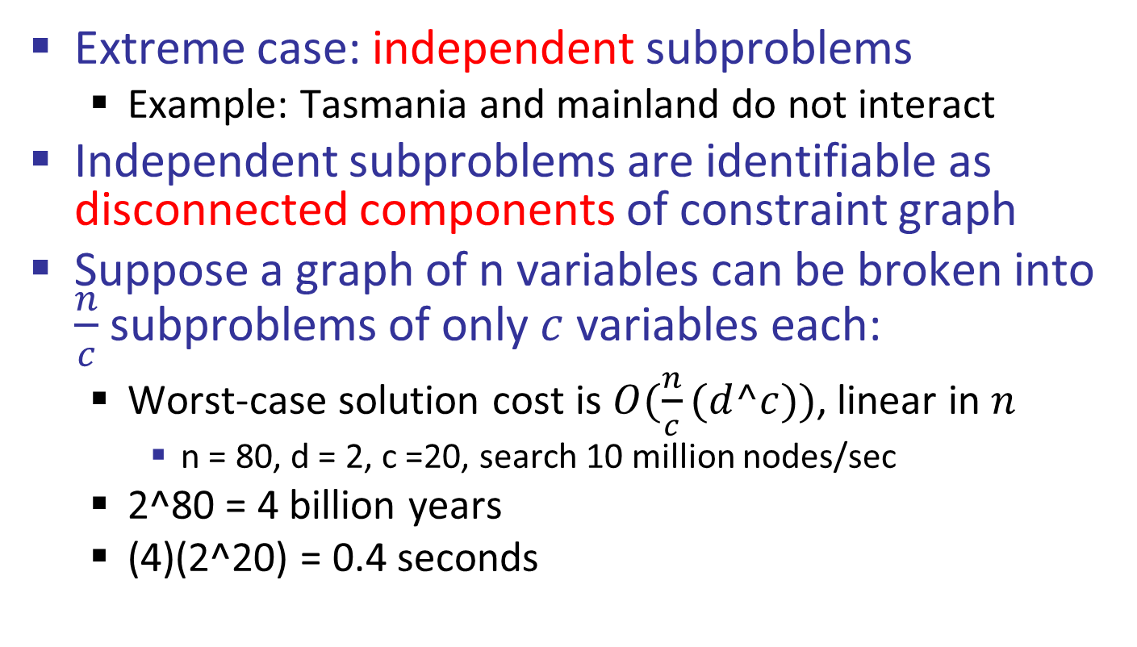
Problem Structure
Extreme case: independent subproblems
Example: Tasmania and mainland do not interact
Independent subproblems are identifiable as disconnected components of constraint graph
Suppose a graph of n variables can be broken into $\frac{n}{c}$ subproblems of only $c$ variables each:
Worst-case solution cost is $O(\frac{n}{c}(d^c))$, linear in $n$
n = 80, d = 2, c =20, search 10 million nodes/sec
2^80 = 4 billion years
(4)(2^20) = 0.4 seconds

Slide 41
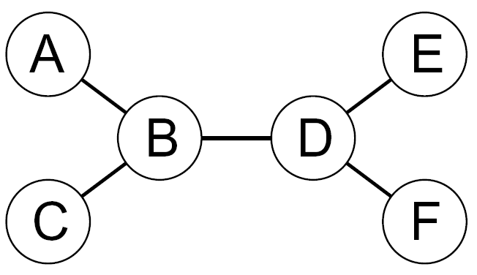
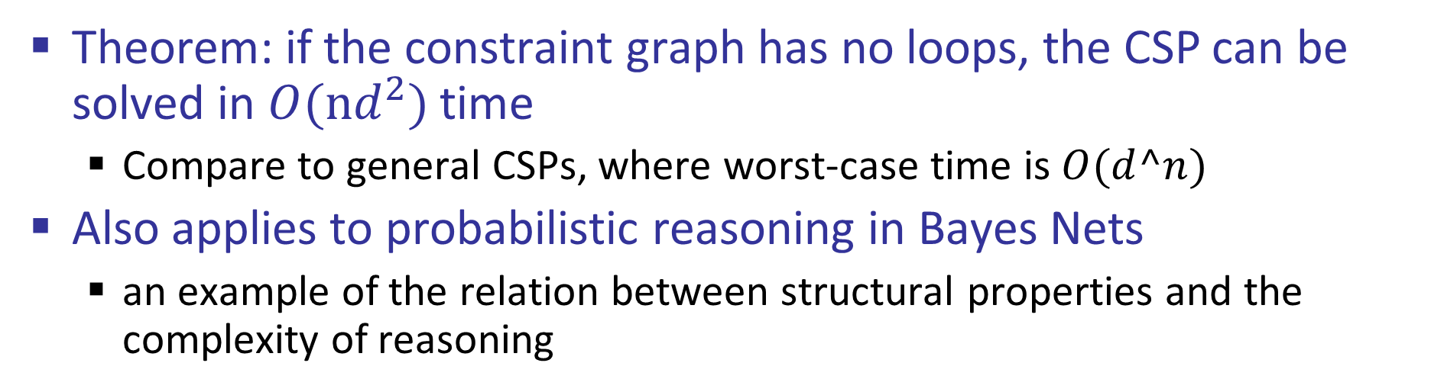
Tree-Structured CSPs
Theorem: if the constraint graph has no loops, the CSP can be solved in $O(nd^{2})$time
Compare to general CSPs, where worst-case time is $O(d^n)$
Also applies to probabilistic reasoning in Bayes Nets
an example of the relation between structural properties and the complexity of reasoning

Slide 42
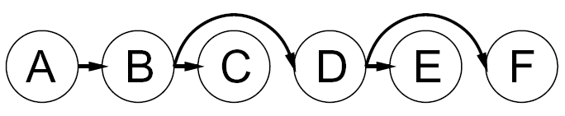


Tree-Structured CSPs
Algorithm for tree-structured CSPs:
Order: Choose a root variable, order variables so that parents precede children
Remove backward: For i = n : 2, apply RemoveInconsistent(Parent(X_{i}),X_{i})
Assign forward: For i = 1 : n, assign X_{i} consistently with Parent(X_{i})
Runtime: O(n d²)
X
X
X

Slide 43
Tree-Structured CSPs
Claim 1: After backward pass, all root-to-leaf arcs are consistent
Proof:
Each X→Y was made consistent at one point
Y’s children were processed before Y
Y’s domain could not have been reduced thereafter
Claim 2: If root-to-leaf arcs are consistent, forward assignment will not backtrack
Proof: Induction on position
Why doesn’t this algorithm work with cycles in the constraint graph?

Slide 44
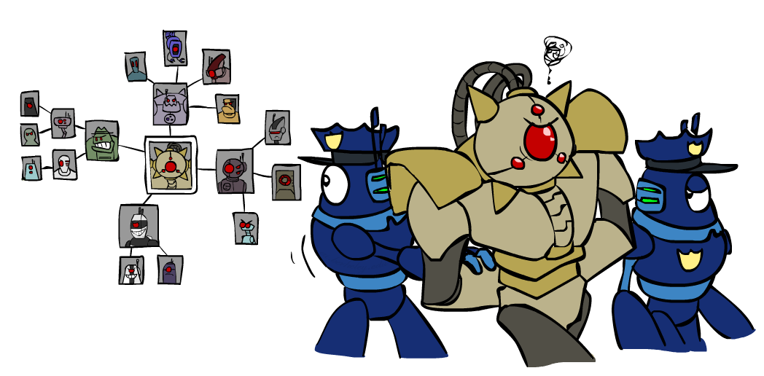
Improving Structure

Slide 45
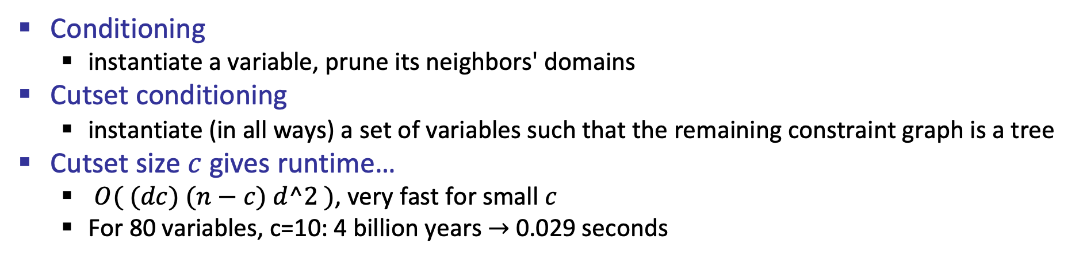
Nearly Tree-Structured CSPs
Conditioning
instantiate a variable, prune its neighbors' domains
Cutset conditioning
instantiate (in all ways) a set of variables such that the remaining constraint graph is a tree
Cutset size $c$ gives runtime…
$O( (dc) (n−c) d^2 )$, very fast for small $c$
For 80 variables, c=10: 4 billion years $→$ 0.029 seconds

Slide 46
Cutset Conditioning
Choose a cutset
SA
Instantiate the cutset (all possible ways)
SA
SA
SA
Compute residual CSP for each assignment
Solve the residual CSPs (tree structured)

Slide 47
Tree Decomposition*
Idea: create a tree-structured graph of mega-variables
Each mega-variable encodes part of the original CSP
Subproblems overlap to ensure consistent solutions
M1
M2
M3
M4
WA
≠
NT
NT
≠
Q
Q
≠
NSW
NSW
≠
V
≠
≠
≠
≠
≠
≠
≠
≠
SA
SA
SA
SA
Agree on shared vars
Agree on shared vars
Agree on shared vars
{(WA=r,SA=g,NT=b),
(WA=b,SA=r,NT=g),
…}
{(NT=r,SA=g,Q=b),
(NT=b,SA=g,Q=r),
…}
Agree: (M1,M2) ∈
{((WA=r,SA=g,NT=b), (NT=b,SA=g,Q=r)), …}

Slide 48
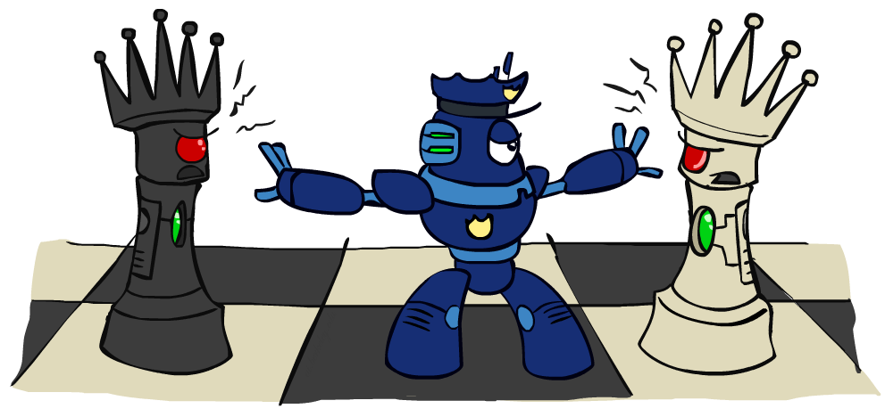
Iterative Improvement

Slide 49
Iterative Algorithms for CSPs
Local search methods typically work with “complete” states
all variables assigned
To apply to CSPs:
Take an assignment with unsatisfied constraints
Operators reassign variable values
No tree, no fringe!
“New age” algorithm
Algorithm
While not solved
Variable selection: randomly select any conflicted variable
Value selection: min-conflicts heuristic:
Choose a value that violates the fewest constraints

Slide 50
Example: 4-Queens
States: 4 queens in 4 columns (4⁴ = 256 states)
Operators: move queen in column
Goal test: no attacks
Evaluation: c(n) = number of attacks
[Demo: coloring – iterative improvement]
Notes:
L5D1 – python demos
Coloring – javascript demos

Slide 51
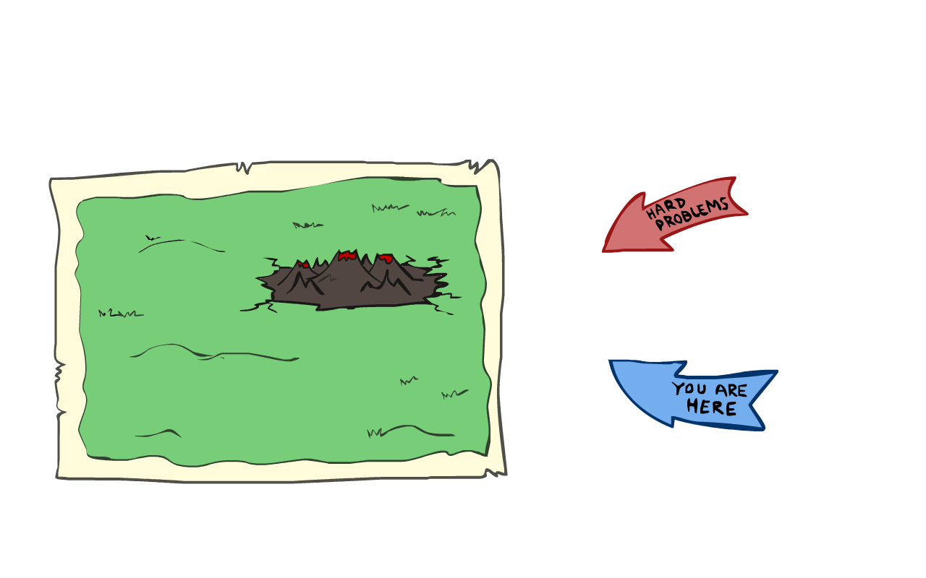
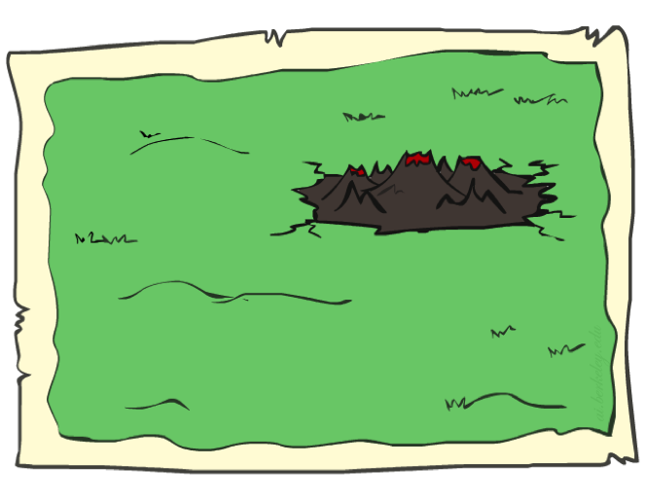
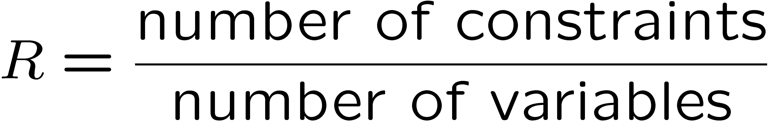
Performance of Min-Conflicts
Given random initial state
can solve n-queens in almost constant time for arbitrary n (for example n = 10,000,000) with high probability
The same appears to be true for any randomly-generated CSP except in a narrow range of the ratio

Slide 52

Summary: CSPs
CSPs are a special kind of search problem:
States are partial assignments
Goal test defined by constraints
Basic solution: backtracking search
Speed-ups:
Ordering
Filtering
Structure
Iterative min-conflicts is often effective in practice

Slide 53
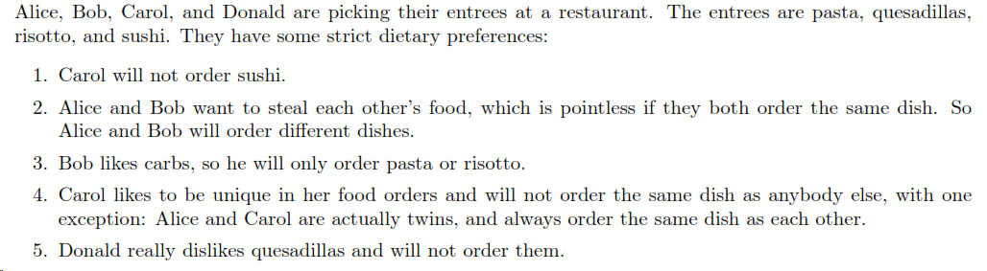
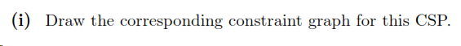
CSPs Problem

Slide 54

CSPs Problem Solution
I.
II.

